Slide 1
Open-gl using c
Making A Window
Using
Project by Carson Mead

Slide 2
Project summary
Create an Open GL “program” using c
Easy to use and simplified
Open to x86 integration and “acceleration”

Slide 3
What is open-gl?
Developed by Vulkan and Kronos Group
Hardware Accelerated Graphical Language
Vector based C API
This Project uses GLFW and GLEW
GLFW:
Window and Context creation library specifically for Open-GL
GLEW:
- Function and Method importer

Slide 4

The power of Documentation :)
FIRST

Slide 5
The Issue With Documentation
Overcomplicated
Not beginner/ user friendly
Difficult to account for every user

Slide 6
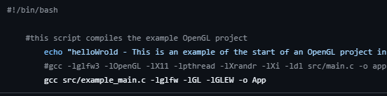
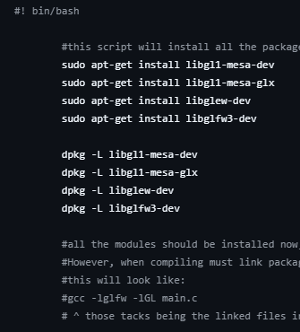

Simplifying the Process
Simple scripts
Downloads and install the exact libraries required
“build” script to compile with linking
OpenGL Simple Starter
Github Page

Slide 7
Back to the project
Making a window 😱

Slide 8
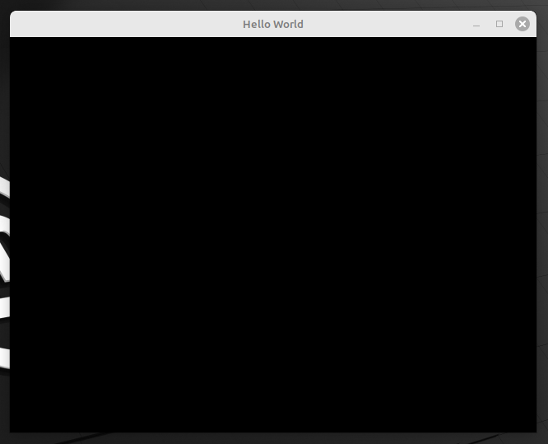
Window requirements
Initialize GLFW
Initialize GLEW
GLFW OpenGL context
GLFW OpenGL window 😐
Buffer loop

Slide 9
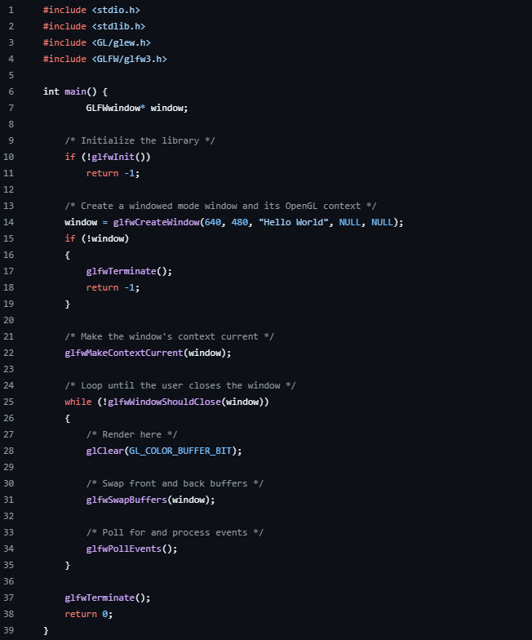

Slide 10


Slide 11

But we want more!
To build more, we need:
Vertex groups
Vertex buffers
SHADERS

Slide 12
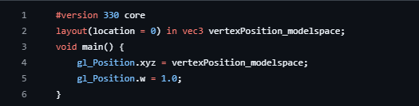
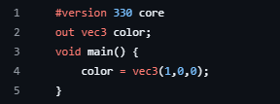
SHaders
Compiled at runtime
Open-GL specific C language
Linking to current program
Vertex Shader
Fragment Shader

Slide 13
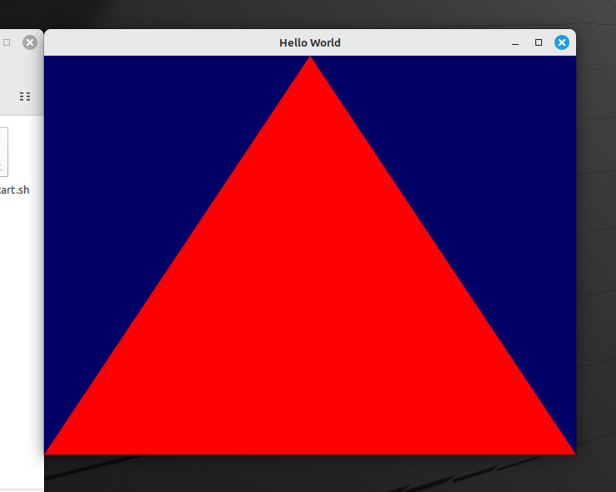

Slide 14
Let’s See the Code!! 😍

Slide 15


Slide 16
Thank you

